Slide 1


Cyber Defence:
Country / Organisation / Self
CRAIG ROSEWARNE
(MBA, CISM, CISSP, ISO27001 Lead Implementer & Auditor, Certified Lead Incident Response Professional)
Notes:
Image source:-

Slide 2
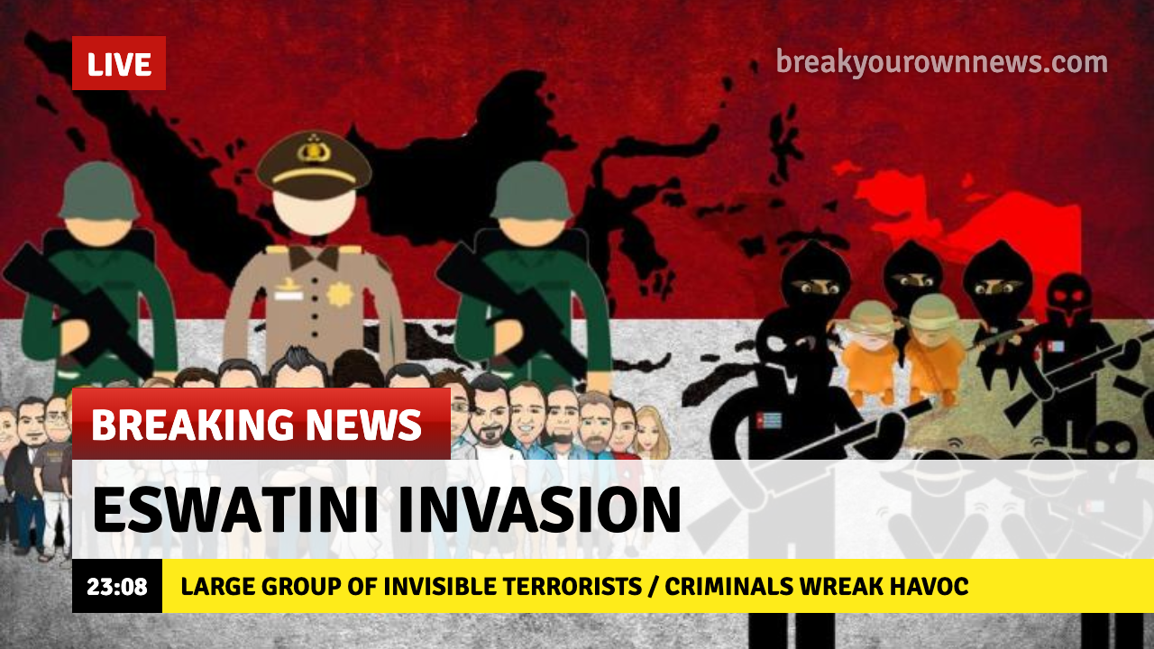

Slide 3
WHO…HOW…WHERE…WHY?
Operations
Impact
Financial
Impact
Threat Actor (Introduces)
Threat (Exploits)
Vulnerability (Leads to)
Exposure
Risk (Can damage)
Asset
Person / Company / Country
Reputation
Impact
Physical
Impact
Notes:
Motive…

Slide 4
Cyber Self Defence – Personal safety hands-on session
Cyber Risk Areas
Organisation Risk – Common vulnerabilities
Country Risk – Key national threats

Slide 5

1
Country Risk
Notes:
Image source:-
https://pixabay.com/en/architecture-building-business-2179108/

Slide 6
The World Economy
Global GDP?
$80.7 Trillion
Cyber GDP?
15% = $12 Trillion
Source: databank.worldbank.org
Notes:
Africa = $2,2 T

Slide 7

INTELLIGENCE GATHERING
INTELLECTUAL PROPERTY THEFT
PROPAGANDA & MISINFORMATION
TERROR FUNDING
CRITICAL INFRASTRUCTURE DAMAGE
DISTRIBUTED DENIAL OF SERVICE
WHO?
HOW?
GOVERNMENT SPONSORED ATTACKS (MILITARY / INTELLIGENCE)
MERCENARY / BLACK HAT HACKERS
TERROR GROUPS
HACKTIVISTS
Notes:
SARS efiling

Slide 8
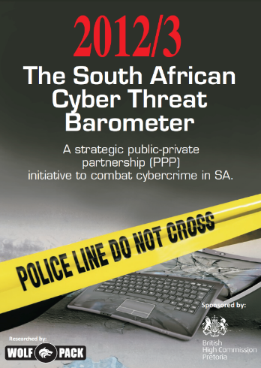
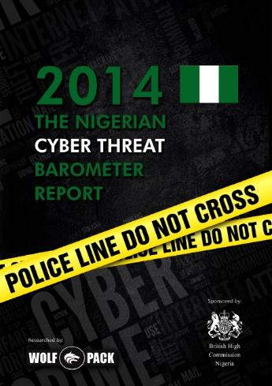
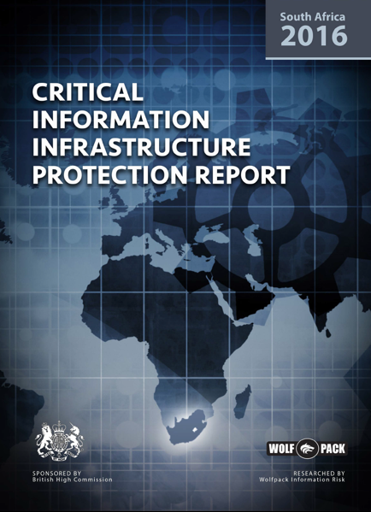
African National Cyber Security Vulnerabilities
SKILLS SHORTAGE
2. LIMITED NATIONAL AWARENESS
3. CRITICAL INFRASTRUCTURE PROTECTION
Edit Text Here
4. CYBER CRIME COMBATTING

Slide 9

Skills Shortage - Training Stream Examples
CRISIS MANAGEMENT
Senior Executives
Risk / BCM committees
Experience crisis situations with realistic cyber-attack scenarios
Test incident response plans
CYBER CHALLENGE FOR IT
IT / Network ops
Service desk / Dev ops / Admins
Understanding cyber threats & vulnerabilities
Theory, classroom exercises & simulated attacks reinforce skills
CYBER DEFENCE ESSENTIALS
IT / Network ops
Security / SOC team
Cyber security defences
Hands-on exercises / tools
Instructor-led APT
INCIDENT RESPONSE
Incident Response Team (IRT)
Key IT / Security / SOC team members
First responder role
Digital evidence collection
Hands-on exercises / tools / APTs
AUDIENCE
LEARNING
OUTCOMES
Skills Assessments / Performance Reports / Skills Development Roadmap

Slide 10
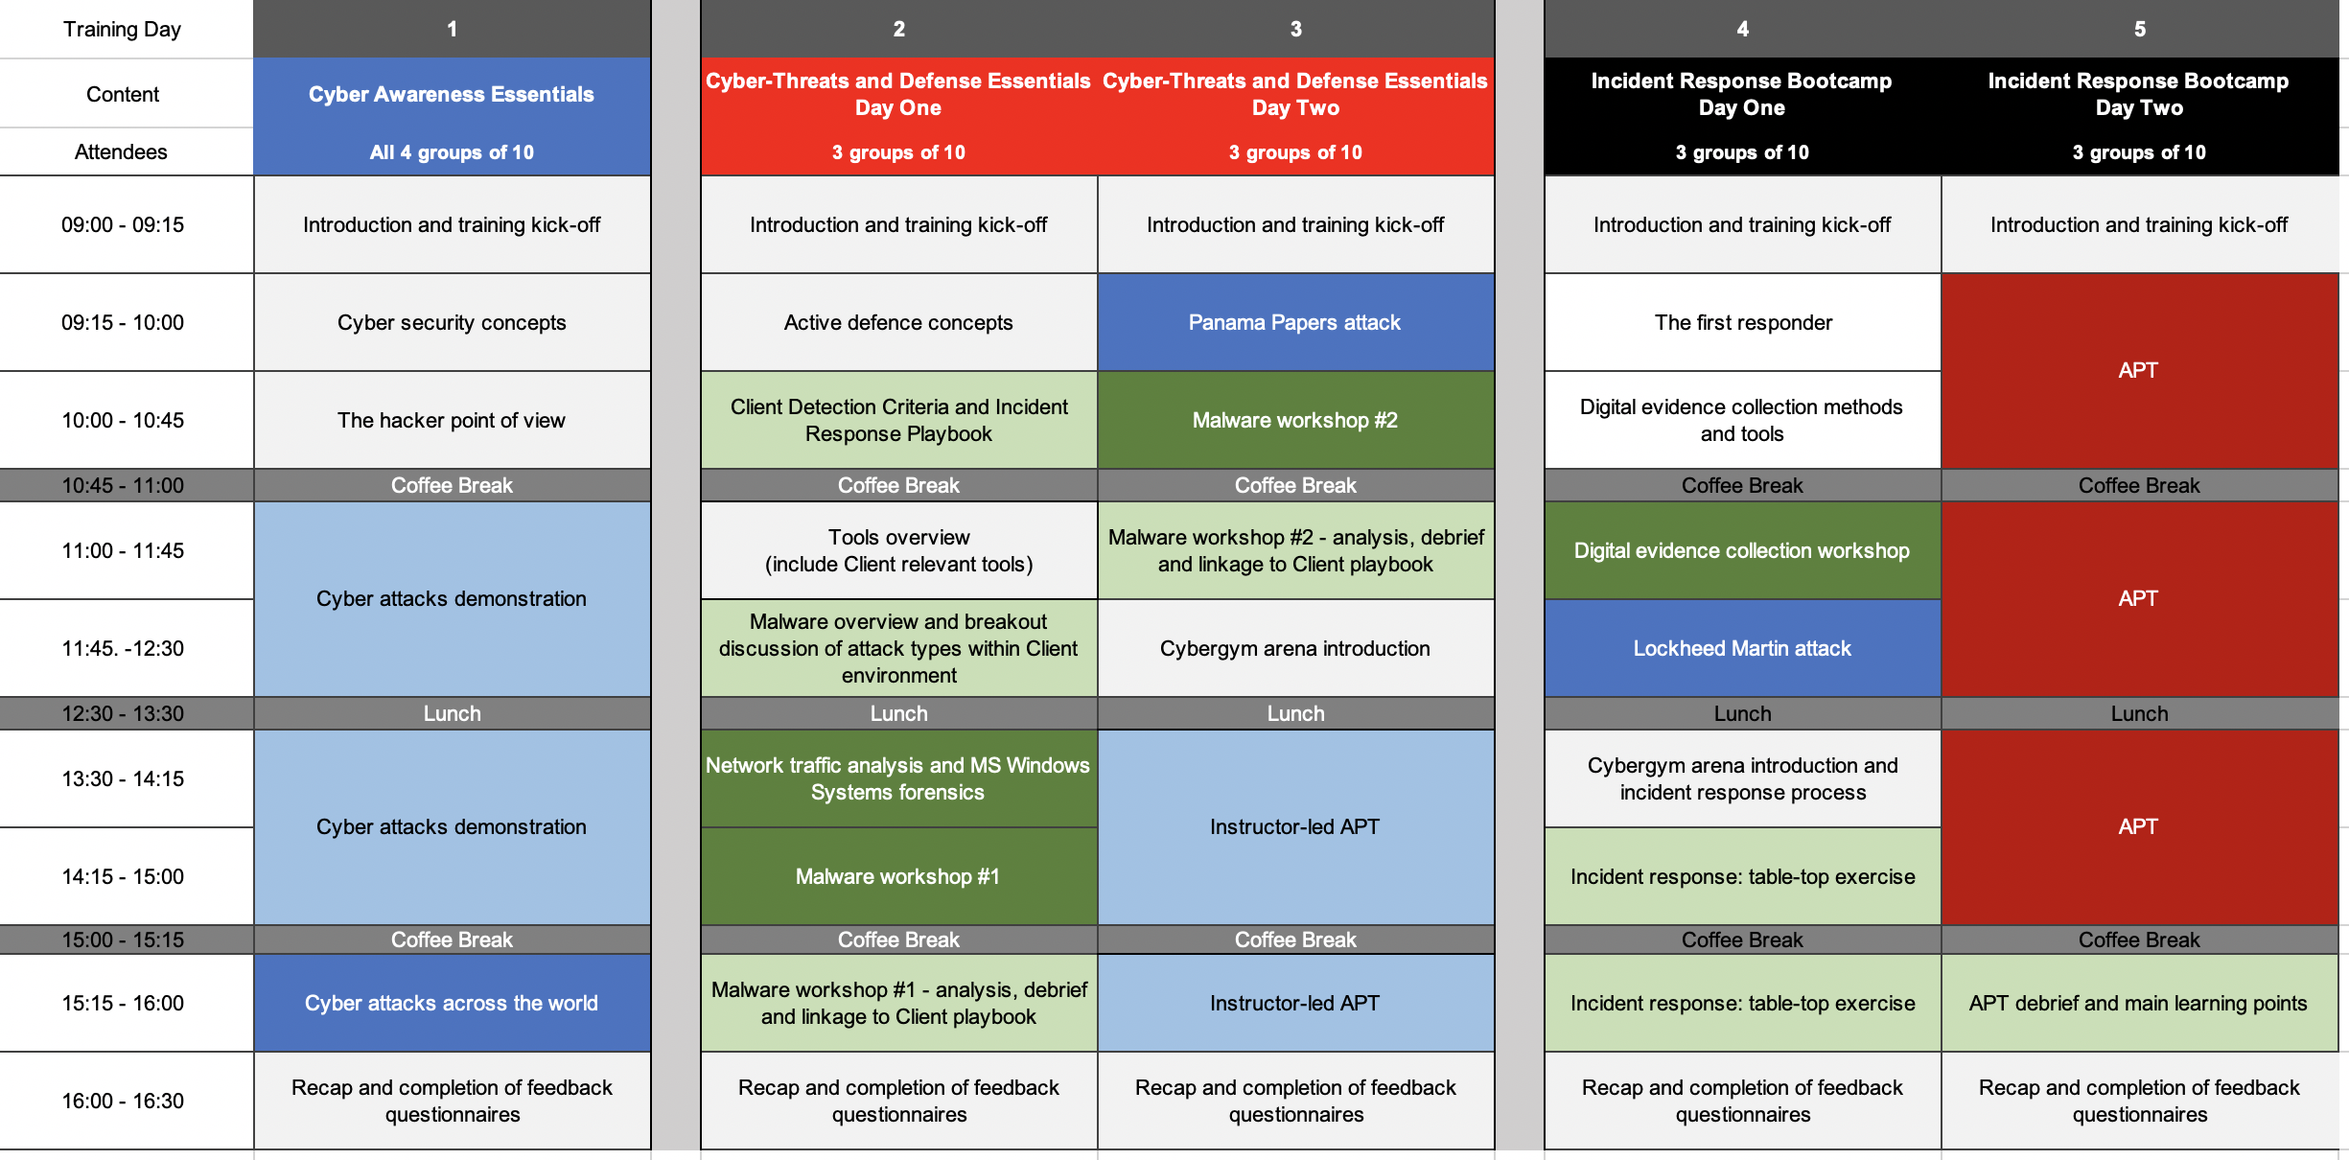
Example Cyber Team Training Example

Slide 11
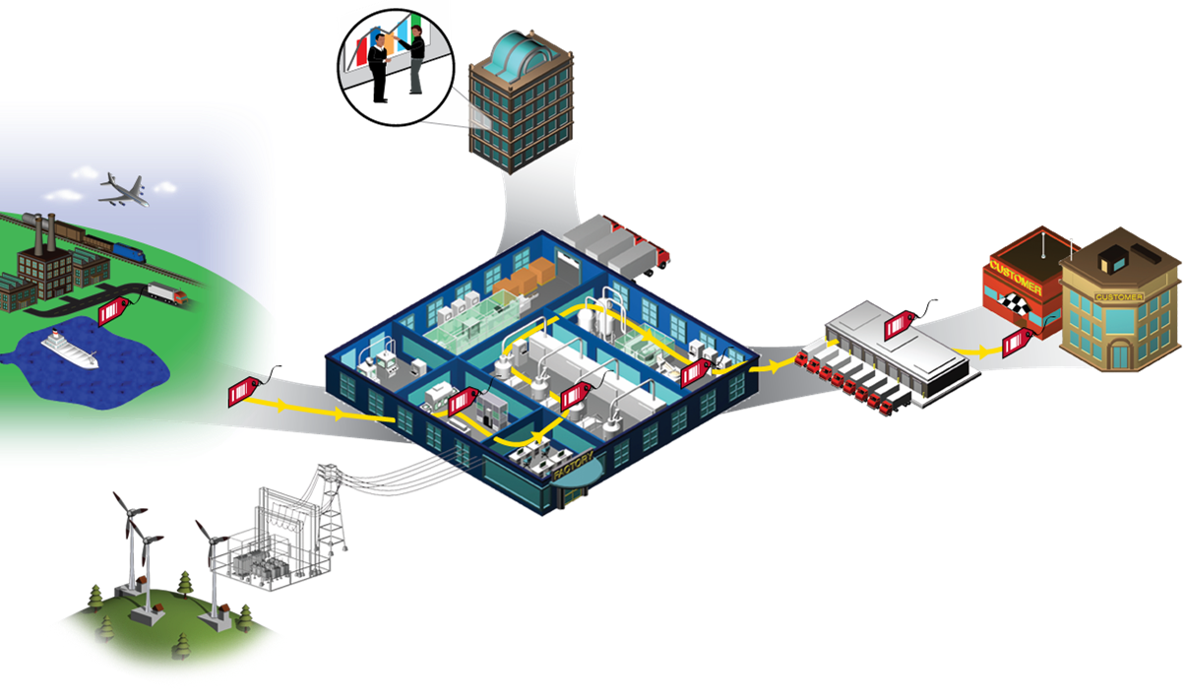
Critical Information Infrastructure Protection - DEMO
Water Systems
Telecommunications / IT
Manufacturing
Transport
Business Systems
Retail
Political
Interference
Ports
Financial
Extortion
Distribution
Supply Chain
Government
Energy
Health

Slide 12

Sector Cyber Risk Collaboration
Political
Interference
Extortion

Slide 13
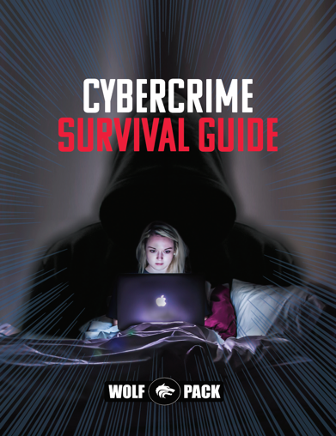
National Awareness Programme Management
Key Drivers:
Governance
Risk
Compliance
Audit Findings
Past Incidents
Resilience
Threat Intel
Policies Processes
Project Risk
STAKEHOLDERS
Executive
Management
High Risk Areas
Users (Incl non-IT)
IT
3rd Parties
CONTENT
Videos
Simulations
Posters
Screensavers
Cartoons
News
Solutions
TOOLS & SERVICES
Threat Simulations
Social & Digital Risk
LMS - Reporting
Training / Workshops
Victim Assistance
2
Programme Management
1
3
4
5
6

Slide 14
Cyber Crime Stakeholder Training / Tools

Slide 15

2
Cyber Self Defence
Notes:
Image source:-
https://pixabay.com/en/architecture-building-business-2179108/

Slide 16

National Cyber Self Defence Training
  Safe Surfing
  Home IT Security
  Safe Banking
  Dark Web
  Scams
  Online Shopping
  Mobile Safety
  Online Predators
  Cyberbullying
  Social Media
  Gaming…
  Understanding the Personal & Business
  Impact of:
CAUTION
INSIDE

Slide 17
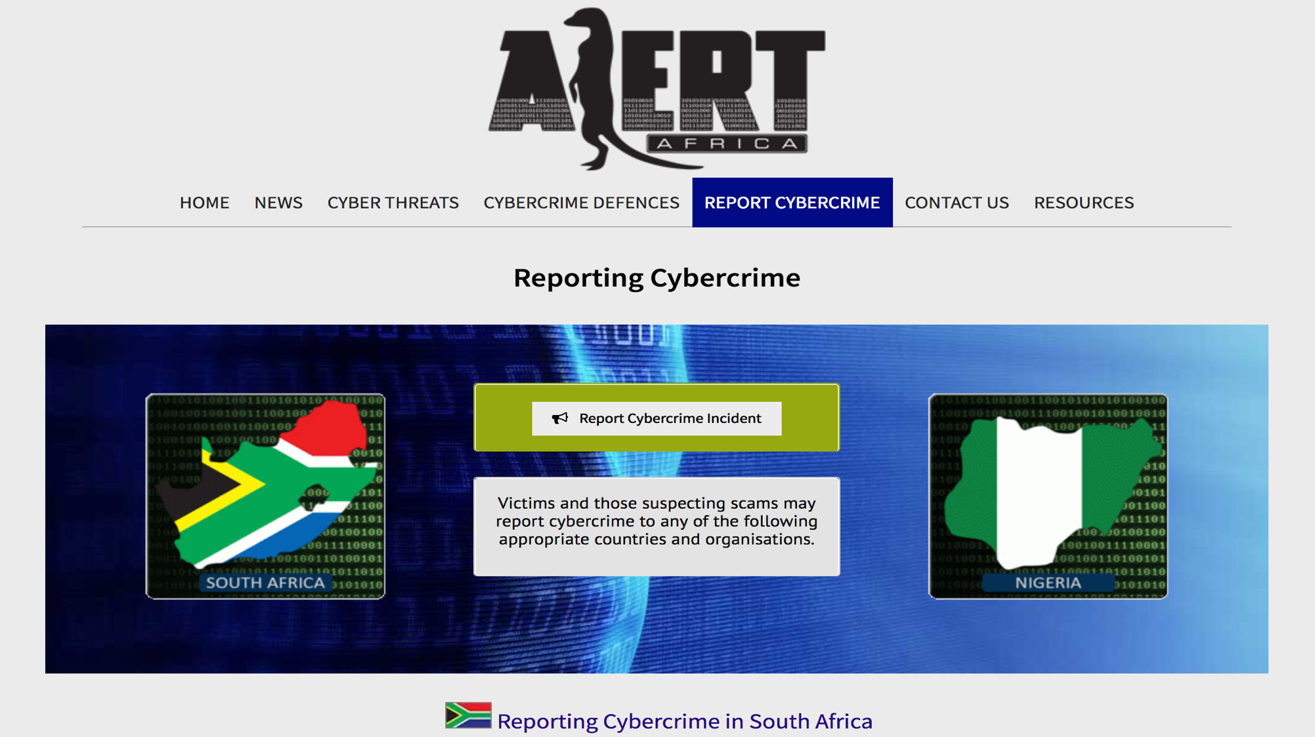
Alert Africa
www.alertafrica.com
17
17

Slide 18
Cyber Scam Categories
Stealing Personal Info
Phishing
Remote Access
Buying or Selling
Classified Scams
False Billing
Dating & Romance
Threats & Extortion
Other…
ID Theft
Hacking
Mobile Premium Services
Online Shopping Scams
Overpayment Scams
Romance Scam / Catfish
The Sugar Daddy
Fake Dating Sites
Malware & Ransomware
Threats to life or arrest
Fake Charities
Investment Scams
Jobs & Employment
Pyramid / Get Rich Quick

Slide 19
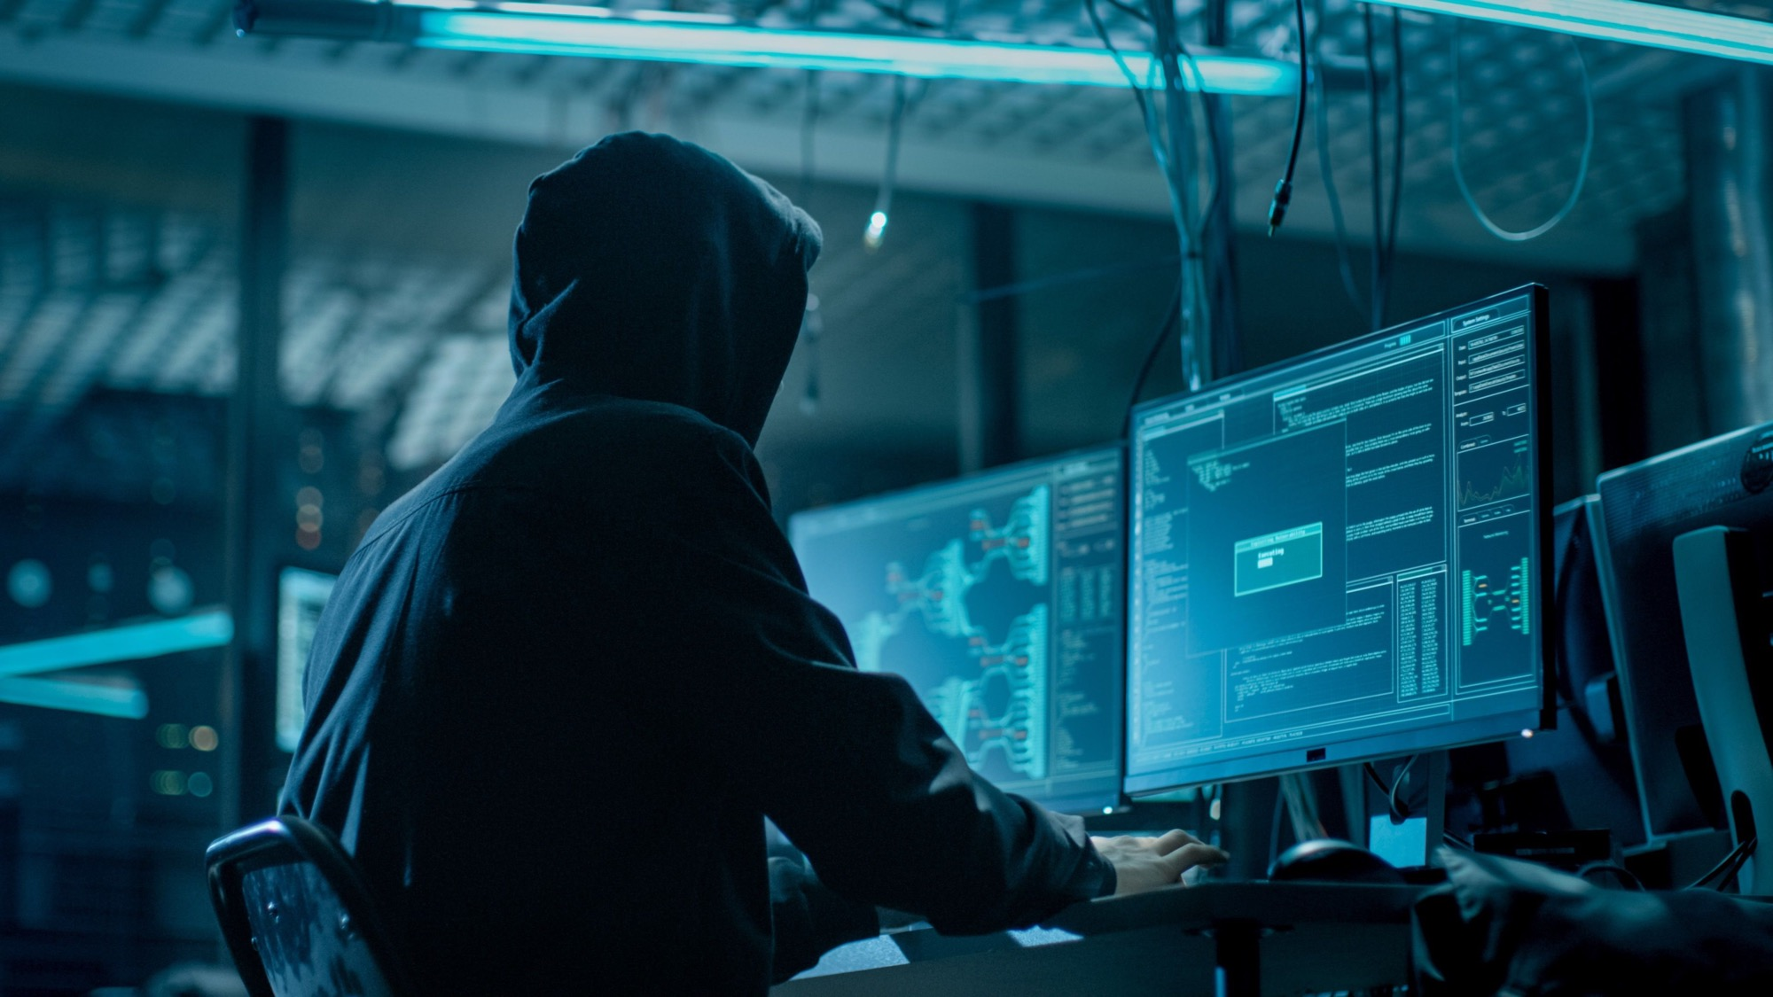
Demo – Fake Identity Creation
Notes:
Disruptive Technologies

Slide 20

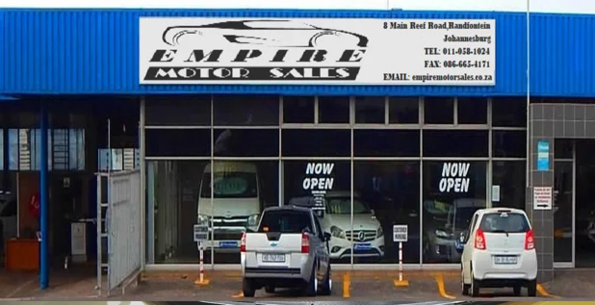
Common African Scams

Slide 21
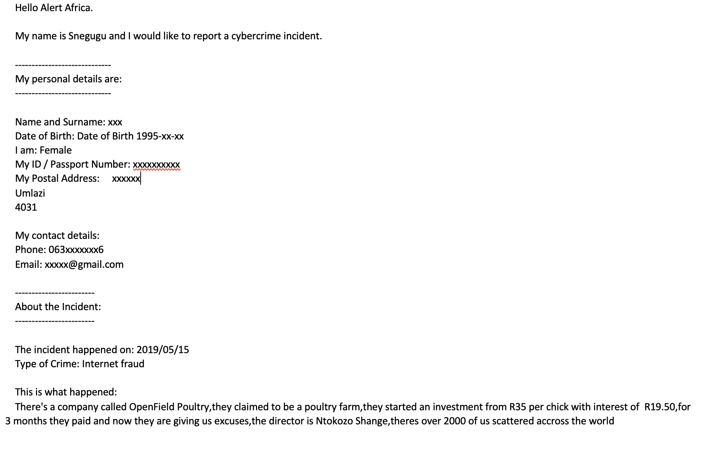
Actual Case – Cyber Fraud

Slide 22

3
Organisational Security
Notes:
Image source:-
https://pixabay.com/en/architecture-building-business-2179108/

Slide 23
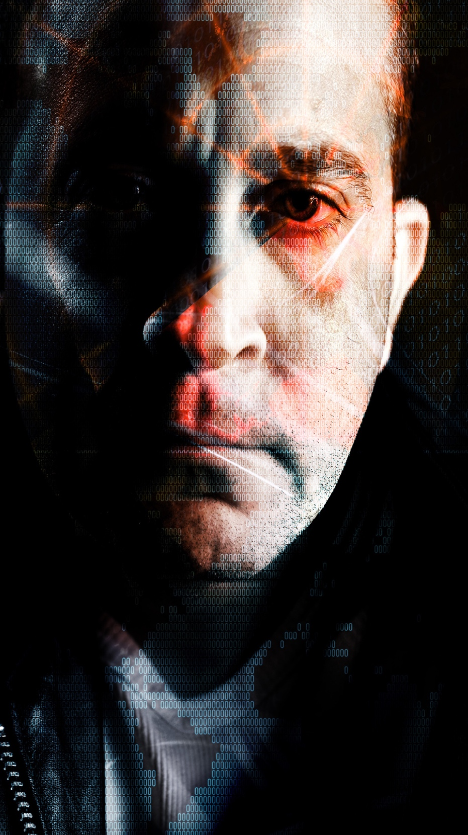
FINANCIAL THEFT
EXTORTION / COLLUSION
SCAMS
BUSINESS DISRUPTION
INFORMATION LEAKAGE
WHO?
HOW?
ORGANISED CRIMINAL SYNDICATES
OPPORTUNISTIC CRIMINALS
CRIME “TOOLKIT” PROVIDERS
MALWARE AUTHORS
Cybercriminal Code of Ethics
“If what you put on the Internet is worth anything, one of us will try to hack or steal it.”
“If you don’t care about protecting your stuff from the likes of us, don’t worry: You’re our favourite type of customer!”

Slide 24
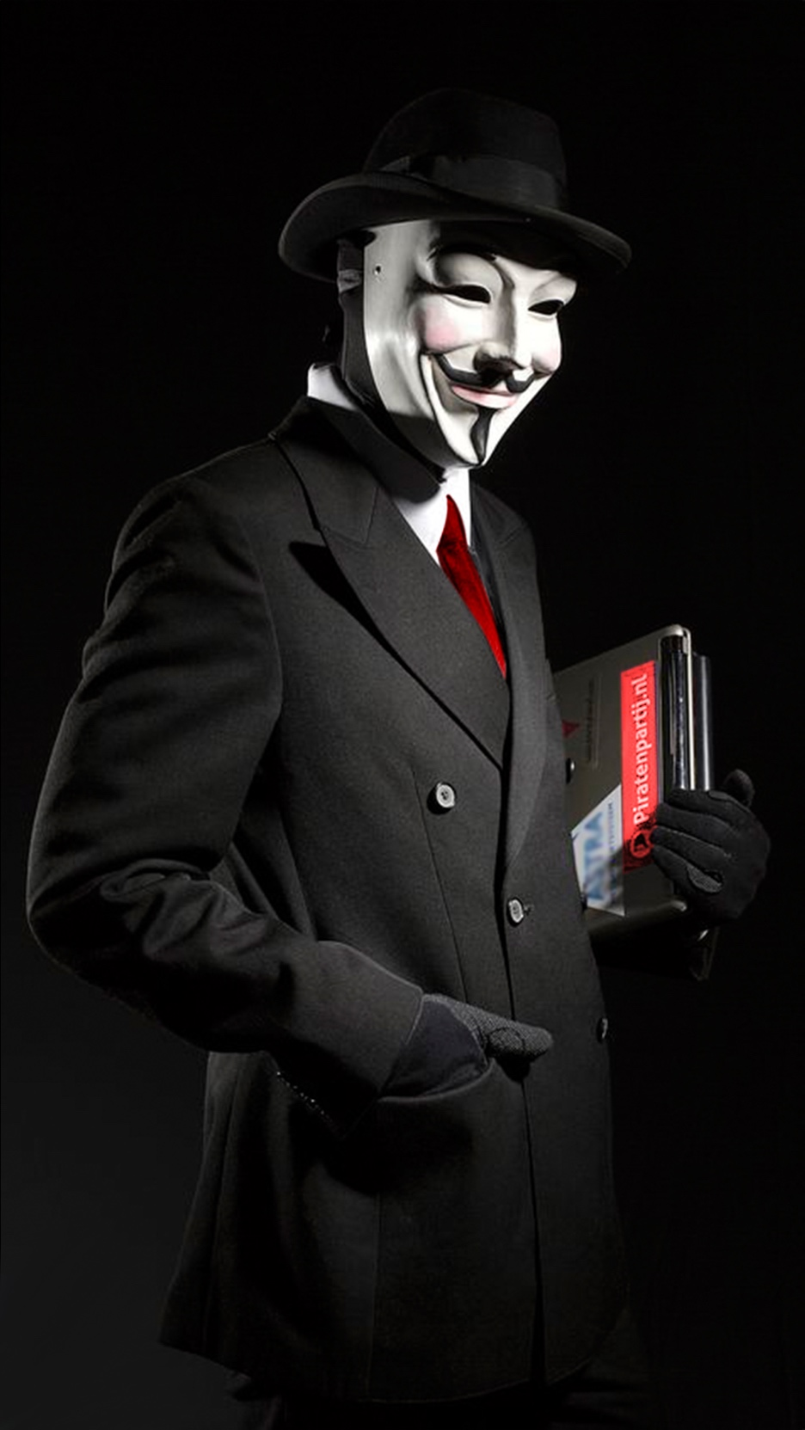
COLLUSION
FRAUD
SOCIAL ENGINEERING
SPEAR PHISHING
INFORMATION LEAKS
EXTORTION
DARK WEB ACTIVITY
RANSOMWARE
WHO?
HOW?
HACKTIVISTS
UNAWARE
EMPLOYEES
RECKLESS
EMPLOYEES
DISGRUNTLED EMPLOYEES
INFORMATION PARTNERS

Slide 25
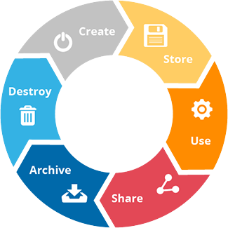
Operational View – Retail Banking
Attract
Customers
Supply
Loans and Mortgages and Credit Cards
Provide
Core Banking Services
Offer
Card Services
Grow Investments and Manage Wealth
Marketing
Management
Lending
Management
Cash
Management
Payment
Processing
Credit Card
Management
Investment Management
Market Research
Origination
Adjudication & Disbursements
Collections & Recovery
Deposit
Management
Correspondent Bank Fulfillment
Card
Facility
Portfolio
Planning
Promotions & Incentives
Lead Qualification
Due
Diligence
Payment
Plans
Currency Exchange
Management
Payment Tracking
Card
Authorization
Trust Service Management
Advertising
Application
Management
Credit
Scoring
Repossessions
ATM Network
Management
Disputes & Chargebacks
Card
Capture
Safety Deposit Box Management
Defining
Pricing & Terms
Check & Draft Processing
Card Billing &
Payments
Needs Assessment
Deal
Closing
Debt Management
Fund Transfer & Remittance
Brokered Product
Management
Brand Management
Information
Management
Payment/ Disbursements
Collection
Management
Central Cash Holding
Merchant
Relations
Business Development
Liquidity
Management
Collateral
Management
Transaction Authorization
Product
Management
Customer
Management
Regulatory
Compliance
Account
Management
Risk
Management
Channel
Management
Product
Innovation
Customer
Care
Retain Customer
AML & Fraud
Management
Account
Setup
Position Keeping & Management
Capital Risk Management
Digital
Banking
Product
Training
Preference Management
Loyalty Management
Guideline Compliance
Billing Management
Counterparty Risk
Credit Risk
Management
ATM &
Kiosk
Shared
Incident
Management
Compliance Reporting
Account
Write-Off
Operational Risk
Management
Contact
Center
Product Catalog
Management
Relationship
Management
Account Monitoring
Product
Servicing
Campaign Management
Complaint
Management
Security Assurance
Capital
Management
Credit Bureau
Reporting
Reputation Risk
Management
Branch
Knowledge
Management
Partner
Management
Enterprise Data
Management
Workflow
Management
Treasury
Administration
Analytics & BI
Settlement & Reconciliation
Transaction Processing

Slide 26
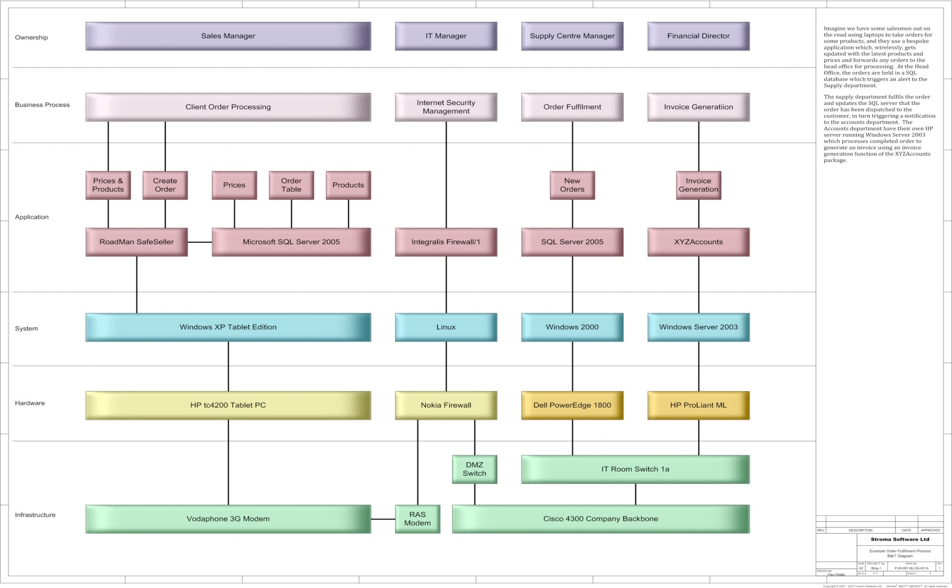

OBASHI – Rapid Mapping of Business / IT Processes

Slide 27
Strategic View – Telecom Services Example
STRATEGIC STAKEHOLDERS
TANGIBLE
ASSETS
INTANGIBLE ASSETS
STRATEGIC CUSTOMERS
International HO
Investors
Regulators
Auditors / Lawyers
IT / Cloud / Internet / Email providers
People
Cash
Core Applications
Infrastructure
Intellectual Property
Brand / Reputation
Goodwill / Relationships
Strategic plans
Large Corporates
Resellers
OEM / Partnerships
VIP Individuals

Slide 28

Notes:
Security for industrial automation and control systems, ISA 62443-2-1:2009

Slide 29
Cyber Crisis Simulation – Phishing Attack
Your security team has reported the following:
  A phishing mail was sent to approximately 50% of your 200,000 clients - the mail included a link to a website asking the victims to change their passwords.
  When the link was opened, a spoofed login website was displayed.
  When they tried to change their passwords, nothing happened.
  The senior leadership group needs an update on recommended actions ASAP.
Notes:
Stevens Mokgalapa
Release an announcement to (all?) customers explaining the issue and asking them to pay attention to further e-mails.
Request all users to change their passwords, it is a possibility to dent access to the website till the password is changed.
Adding additional security on our website such as a two-factor authentication mechanism.
Adding security systems to prevent receiving phishing mails such as mail filtering systems.
I want an update in 10 mins on a recommended communication plan!

Slide 30
Cyber Security Priorities
COULD / WANT (LOW)
SHOULD (HIGH)
MUST (CRITICAL)
High Priority Risks
Requirements
Projects
Requirements
Projects
Business Requirements
Requirements
Projects
Requirements
Projects
Requirements
Projects
Requirements
Projects
Requirements
Projects
IT Requirements
Requirements
Projects
Requirements
Projects
Lower Priority Risks
Requirements
Projects
Governance, Risk, Compliance Requirements
HR Requirements
Sales & Marketing Requirements

Slide 31
Prioritisation of Requirements
Prioritisation ensures that the business operations team focuses on the important requirements.
Must Have
Should Have
Could Have
Want to Have
CRITICAL - Requirements that must be considered first & implemented immediately.
HIGH - Requirements that are a high priority and should be included in the solution if possible.
NICE TO HAVE - Requirements that are desirable but not a priority and could be included if resources are available.
Security Programme
NOT NOW - Requirements that won’t be considered in this phase, but may be considered in future.
Prioritisation is the process of ranking each requirement based on its importance to business requirements. Hold a separate meeting for the domain SMEs, implementation SMEs, project managers, and project sponsors to prioritise the requirements list. At the conclusion of the meeting, each requirement should be assigned a priority level. The implementation SMEs will use these priority levels to ensure that efforts are targeted toward the proper requirements and the plan features available on each release.

Slide 32
Develop an Effective Risk Management Programme
BUSINESS
Governance, Compliance & Risk
IT
HR
Sales & Marketing
Audits| Risks | Laws Cyber Risk | IT Risk Goals | Projects People Risk | Skills Brand | Social Media
(IT) GOVERNANCE / RISK / COMPLIANCE
INFORMATION & CYBER SECURITY
BUSINESS-ALIGNED PROGRAMME
Policy & Standards Refresh
Security Framework
Privacy & Data Protection
Data Governance & Classification
Awareness Programme
Training Programme
Incident Management
DR / BCM

Slide 33
Cyber Security Framework
Context and Leadership
Evaluation and Direction
Compliance, Audit, and Review
Information Risk Strategy
Security Risk Management
Security Compliance Management
Internal Security Audit
Governance
Organisational Structure
Security Policies, Standards & Procedures
External Security Audit
Steerco - Management Review of Security
Culture & Awareness
Security Strategy & Communication
Prevention
Identity Security
Infrastructure Security
HR Security
Identity & Access Management
Network Security
Vulnerability Management
HR Security & Skills
Data Security
Endpoint Security
Cryptography Management
Change and Support
Asset Management
Malicious Code
Physical Security
Configuration & Change Management
Operations
Data Security & Privacy
Application Security
Cloud Security
3rd Party / Vendor Management
Detection
Response and Recovery
Measurement
Security Threat Detection
Security Incident Management
Security eDiscovery & Forensics
Metrics & Reporting
Log & Event Management
Backup & Recovery
Business Resilience
Continuous Improvement

Slide 34

HANDS-ON: PASSWORDS
Notes:
http://pixabay.com/en/coffee-coffee-mug-pen-mobile-phone-569178/

Slide 35
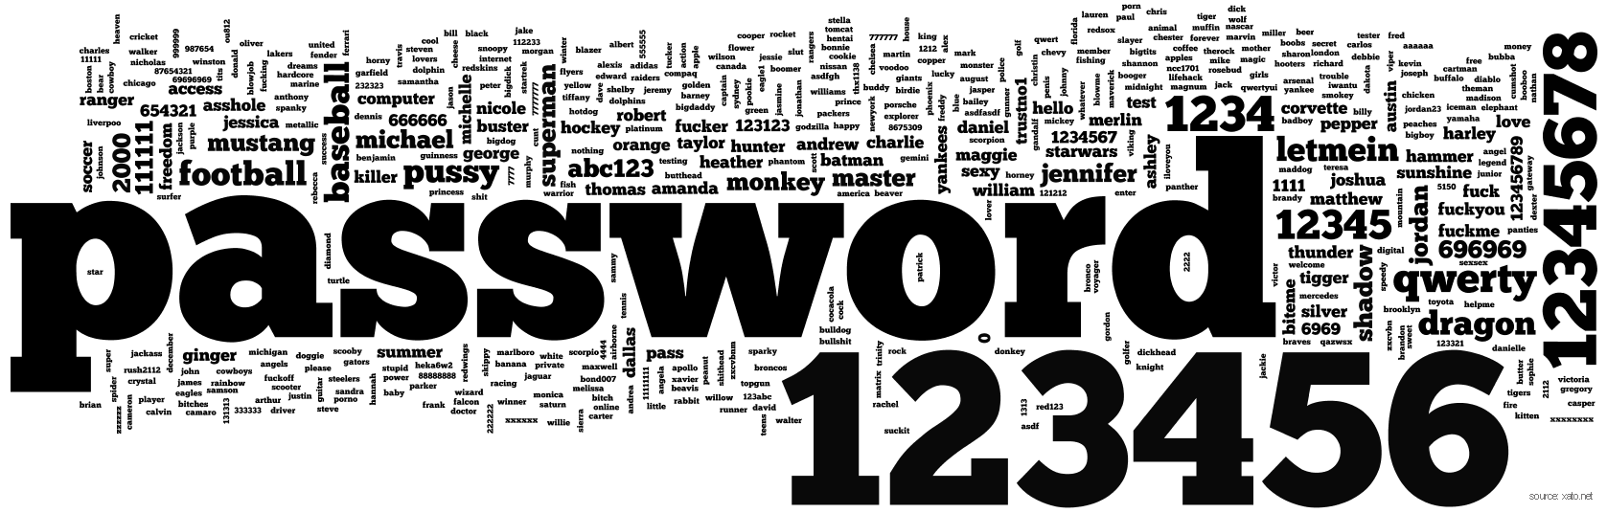

Creating Strong Passwords
https://password.kaspersky.com/
Notes:
The Windows password is usually "hashed" and stored in the Windows SAM file or security account manager file. The file is located on your system at this particular file path: C:\Windows\System32\Config.
However, on normal boot up of your operating system, this file is not accessible. The hash values are also stored in a different location, which is your registry. This will be stored in the following location: HKEY_ LOCAL_MACHINE\SAM.
There are several methods and tools to accomplish this, including physical access to the SAM file. One of the easiest ways, especially if you have physical access to your hard drive, is to use a different operating system to boot your computer. One way to do this is by using a Linux live CD which can read NTFS drives. Once you mount the Windows partition, you can simply copy the SAM file to external media such as a USB drive or a writable DVD or CD.
https://www.passmoz.com/where-windows-password-stored.html

Slide 36
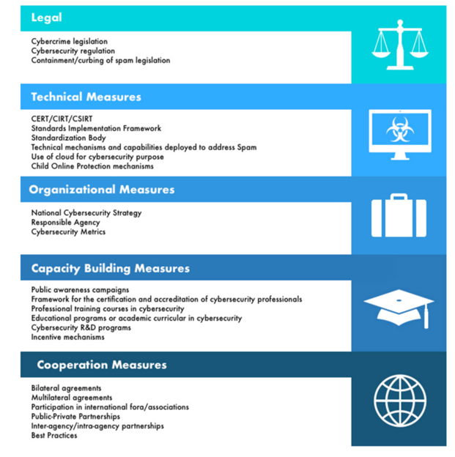
Global Cybersecurity Index 2018 – SA/NIGERIA?
LEVEL 4 75 - 100%
LEVEL 3 50 - 74%
LEVEL 2 25 - 49%
LEVEL 1 0 -24%
Source : International Telecommunication Union (ITU) - 194 ITU Member States
Notes:
Criminal Dashboard

Slide 37
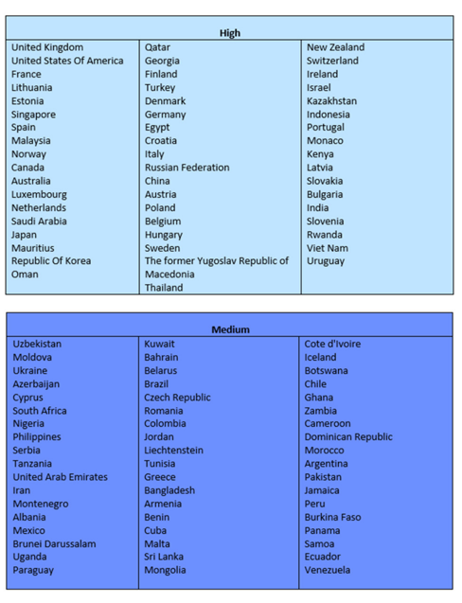
Global Cybersecurity Index 2018
56 & 57 /175
Notes:
Criminal Dashboard

Slide 38


Questions?
Building 1, Pendoring Office Park, 299 Pendoring Office Park, Northcliff, South Africa.
info@wolfpackrisk.com
www.wolfpackrisk.com
(+27) 11 794 7322
Notes:
Image source:-
https://pixabay.com/en/coding-programming-working-macbook-924920/

Slide 39

Wolfpack Information Risk (Pty) Ltd
ESTABLISHED: July 2011
BBBEE LEVEL: Level 2 Contributor
SECURITY CLEARANCE: Wolfpack are security cleared by the SA State Security Agency and SA Reserve Bank
LEADERSHIP: C Rosewarne (Director), B Gwala (Director), A Hingeston (Non-Exec Director)
WE ARE AN INDEPENDENT SOUTH AFRICAN INFORMATION RISK SERVICES COMPANY
We specialise in business-aligned information risk and cyber threat management covering the full spectrum of prevention, detection, incident management and resilience requirements.
SERVICES:
Advisory – Strategic Alignment, Information Risk, Cyber Security, Privacy, Incident Management, Disaster Recovery & Business Resilience
Managed Services – Remediation, Online Brand & Social Media Risk Monitoring
Training – Immersive Risk & Cyber Security Programmes
Awareness – Awareness Programme Management & Human Vulnerability Testing
Community – Cybercrime Assistance
PROTECTION IN THE PACK
PARTNERSHIPS: We incorporate specialist skills from trusted local & international partner organisations in the strategic business, forensics, legal & technology sectors.

Slide 40

Your Presenter
Craig is the MD of Wolfpack Information Risk - a South African firm established in 2011 that specialises in cyber threat intelligence, research, training, awareness and advisory services. A community of 9000+ information and cyber security specialists subscribe to their regular community updates.
Wolfpack provides cyber risk management to government & organisations & also run pro-bono community initiatives to support victims of cybercrime or harassment. He provides regular opinion pieces via TV, radio and print/online media, including:
Craig has over 18 years of management experience in the fields of IT & cyber security. He is frequently invited to speak at local & international information security, cybercrime and counter-espionage events.
He is proudly South African and an even prouder husband and father to three healthy “cubs”.
Craig Rosewarne
MBA, CISSP, CISM, CVE, ISO 27001 Lead Implementer & Auditor, ISO 27035 Lead Incident Response Professional, Certified ISO 27005 Risk, COBIT & ITIL trainer

